Slide 1
Data Transmission and Telemetry
In modem measurement systems, the various components comprising the system are usually located at a distance from each other. It, therefore, becomes necessary to transmit the data or an information between them through some form of communication channels.
The terms data transmission and telemetry refer to the process by which information regarding the quantity being measured, may be using a transducer and signal conditioning equipment, is transferred to a remote location, perhaps to be processed, recorded and displayed. Telemetry is the technology which enables a user to collect data from several measurement points at inaccessible or inconvenient locations, transmit that data to a convenient location, and present the several individual measurements in a usable form.

Slide 2
METHODS OF DATA TRANSMISSION
The transmission of a measured variable to a remote point is an important function in Instrumentation systems because of the size and complexity of morden industrial plants. The most common variables encountered in industrial plants are temperature, pressure and flow. Most measuring devices for these variables such as mercury thermometers, pressure gauges or flow rate meters would require fluid-line connections of great length from the place of measurement to the place of data recording or display. This will result into excessive measurement lags. Hence, there is a need for fast transmission of data.
The methods employed for data transmission depend upon the variable and the distance over which it has to be transmitted. The following methods may be used for data transmission :
Hydraulic transmission,
Pneumatic transmission, and
Electrical and Electronic transmission.
The electrical and electronic methods of data transmission are extensively used in Instrumentation and measurement systems.

Slide 3
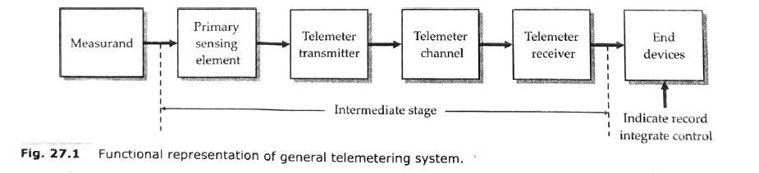
GENERAL TELEMETRY SYSTEM
Telemetry may be defined as measurement at a distance. A general telemetering system is shown in Fig. 27.1. The primary detector and the end device of the telemetering system have the same position and functional roles as in a generalized measurement system. However, there are three system elements in the intermediate stage which are peculiar to a telemetering system, they are :
telemeter transmitter,
telemeter channel,
telemeter receiver.

Slide 4
The function of the telemeter transmitter is to convert the output of a primary sensing element into an electrical signal and to transmit it over a telemetering channel. This signal is in electrical format and is received by a receiver placed at a remote location. This signal is converted into a usable form by the receiver and is indicated or recorded by an end device, which is graduated in terms of the measurand. The end device may be a control element which may be used for the control of the input quantity (measurand), through a feedback loop to produce desired output.

Slide 5
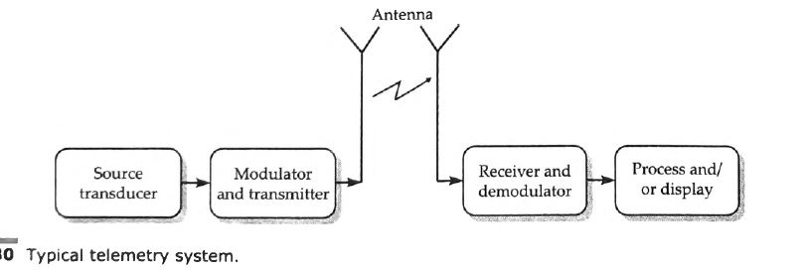
TELEMETRY SCIENCE
Telemetry is the science involved in performing a measurement at a remote location and transmitting
the data to a central location for processing and/or storage. Three basic parts comprise the typical telemetry system (Fig. 27.30) : (1) the data source, which is usually a transducer that converts the measured parameter into an electrical signal ; (2) the mode of transmission of the data ; (3) the receiving station and the recovery of the transmitted data.

Slide 6
TYPES OF TELEMETRY SYSTEMS
Two types of telemetering systems are used :
Land line telemetry,
R.F. (radio frequency) telemetry.
1. LAND LINE TELEMETERING SYSTEM
A land line telemetring system requires a telemeter channel which is a physical link between the telemeter transmitter and receiver. This physical link may be a cable, a specially laid out wire, existing telephone and telegraph cables or a power line carrier.
The land line telemetering is, in fact, a direct transmission of information through cables and transmission lines. The direct transmission via cables employs current, voltage, frequency, position or impulses to convey the information.
Current, voltage and position type systems can be used only for short distances while for long distance telemetry, pulse and frequency types of systems are used.
The information may be in the form of analog or digital signals. While current, voltage, position, frequency and pulse types of signals can be used for analog telemetry, only pulse signals can be used for digital telemetry.

Slide 7
The land line telemetry systems can be classified as :
voltage telemetering systems,
current telemetering systems, and
position telemetering systems.
Voltage Telemetering Systems
A voltage telemetering system transmits the measured variable as a function of an a.c. or d.c. voltage.
Current Telemetering System
A current telemetering system transmits the measured variable as a function of an a.c. or d.c. current.
Position Telemetering System
A position telemetering system transmits and reproduces the measured variable by positioning variable resistors or other electrical components in a bridge circuit form so as to produce proportional changes at both the transmitter and receiver ends.

Slide 8
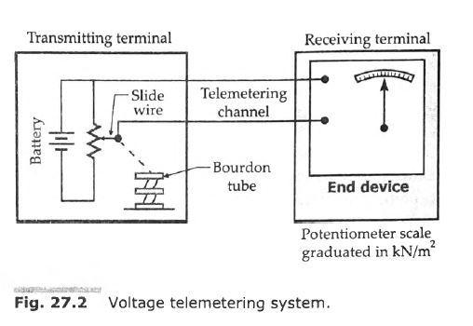

Slide 9
In the land line telemetry, the two primary considerations are :
economy and (ii) reliability.
In the land-line telemetry, the greatest advantage is the simplicity of the set-up as space required and weight are generally of no consideration.
However, the disadvantages are :
all the transmission link distortions are directly introduced into the system. This is particularly true of induction effects of mains frequency from nearby cables.
the effects of thermo-electric emfs may be substantial in case d.c. telemetry systems are used.
(iii) the frequency response is limited.
(iu) signal multiplexing tends to be impracticable.

Slide 10
2. RADIO FREQUENCY (R.F.) TELEMETRY
The telemetry, earlier on, has been defined, as a technology that enables the user to collect data from several measurement points at inaccessible or inconvenient locations. This is very true of applications which require Radio Frequency (R.F.) telemetry, as in such applications, there is no physical link between the transmitting and receiving stations. The link between the transmission station (where the actual measurements are being carried out) and the receiving station (where the measurand is measured, recorded and information used for control purposes) can only be established through radio links.
For example, an aircraft on a test flight has many parameters which change during the flight i.e., fuel flow, amount of fuel, engine performance, vibrations of critical parts, performance of avionic systems, temperature of various components. The test pilot can monitor some of these, of course, by observing the readings of the meters on the panel, but time permits reading those instruments which are critical to the safety of the flight and even those are not sufficiently accurate for detailed flight analysis.

Slide 11
An alternative would be taken along a team of specialist engineers involved in the design, production of the air-craft and analysis of the data produced and to suggest the corrective actions. This solution is just not practicable.
Another, alternative would be to put a sophisticated computer on the flight for analysis of data. This again is not a satisfactory solution.
The best way is to locate the team of engineers on a land based station and the test data be transmitted through radio links from the air-craft to the land station. The team of engineers and the computer stationed on land are in a much better environments to analyse the data and suggest the corrective measures.
R.F. telemetry is usually more suitable if the data is to be transmitted over distances greater than 1 km.

Slide 12
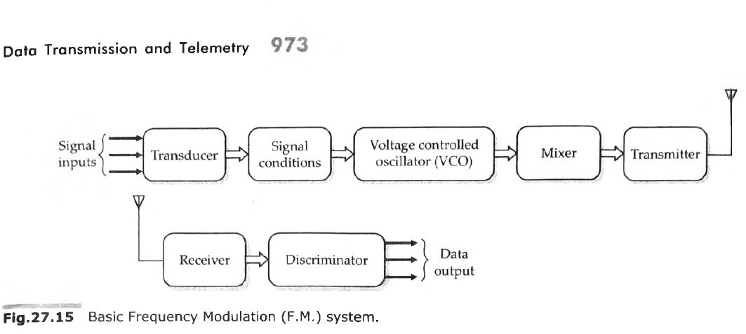

Slide 13
TRANSMISSION CHANNELS AND MEDIA
The most extensively used transmission media are cables and electromagnetic radiation radio links. However, optical, ultrasonic and magnetic induction data links are also used for many applications.
Landline telemetry utilizes cables or wires to transmit data from industrial process plants and power generation stations to central monitoring and control units.
When the data is to be transmitted over lengths greater than 1 km, radio links are usually more suitable. Certain parts of the radio frequency spectrum are allocated for telemetry. The microwave links are used above about 4 MHz. Radio waves at these frequencies tend to travel in a straight line, requiring repeater stations every 30 - 60 km away.
Short range non-contact data links of approximate lengths up to 50 m, such as those used force rotating machinery and power lines generally use either FM radio, optical or ultrasonic methods.

Slide 14
The common communication channels used for telemetering are :
(i) wire line channels
(ii) microwave channels,
(iii) radio channels, and
(iv) power-line carrier channel.
1. Wire Line Channels
For land-line telemetry wire line channels are used. The wire line is the simplest type of channel for transmission of information. The wire lines may be : (a) privately owned or (b) leased from Posts and Telegraphs Department.
For land-line telemetry an enormous variety of connectors are employed. They range from, a pair of open wires, a pair of twisted wires, wires of a telephone cable, to co-axial cables.
2. Radio Channels
Where longer distances are involved, or where measurements have to be made in a missile or moving vehicle, it may be necessary to use radio frequency (RF) techniques to transmit information

Slide 15
3. Microwave Channels
Microwave is a special case of radio transmission.
The necessity for a large number of communication channels in industries like power and gas transmission and the overcrowding of spectrum in the radio frequency range has led to the increased use of microwave radio transmission. Several bands in the range of 890 MHz to 30 GHz have been allocated for microwave transmission.
4. Power Line Carrier Channels
The use of power line carriers has been prevalent for a long time to transmit information between the central generating station and the local substations.
They utilize the power line equipment for this purpose.
An a.c. carrier is coupled to the a.c. voltage transmission line and the information to be telemetered is superposed upon the transmitted power.

Slide 16
Application of Telemetry system
In software development, telemetry systems are used with an end user's permission to remotely monitor the security, health and performance of applications. The information developers get from these systems provides insights into how their applications are performing without the need of feedback from users.
Telemetry is also used in the following fields:
Meteorology. Weather balloons and other meteorological devices use telemetry system to collect and transmit meteorological data such as temperature and barometric pressure.
Agriculture. Wireless weather stations and sensors gather data on the environment, such as temperature, humidity and solar radiation, that helps farmers make decisions about what and when to plant crops.
Space exploration and defense. NASA and the U.S. military use telemetry to monitor the location, performance and health of satellites, spacecraft and aircraft.
Healthcare. Individuals with heart conditions or other medical issues use telemetry devices to monitor heart rate, blood pressure and other vital statistics. This use of telemetry in healthcare is sometimes referred to as biotelemetry.

Slide 17
What is data transmission?
Data transmission refers to the process of transferring data between two or more digital devices. Data is transmitted from one device to another in analog or digital format. Basically, data transmission enables devices or components within devices to speak to each other.
How does data transmission work between digital devices?
Data is transferred in the form of bits between two or more digital devices.
There are two methods used to transmit data between digital devices: serial transmission and parallel transmission.
Serial data transmission sends data bits one after another over a single channel.
Parallel data transmission sends multiple data bits at the same time over multiple channels.

Slide 18
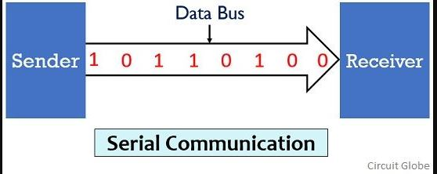
Definition of Serial Communication
In serial communication the data bits are transmitted serially over a common communication link one after the other. Basically it does not allow simultaneous transmission of data because only a single channel is utilized. Thereby allowing sequential transfer rather than simultaneous transfer.
It is highly suitable for long distance signal transmission as only a single wire or bus is used. So, it can be connected between two points that are separated at a large distance with respect to each other. But as only a single data bit is transmitted per clock pulse thus the transmission of data is a quiet time taking process.
The figure below shows the serial data transmission:

Slide 19
Serial transmission has two classifications: asynchronous and synchronous.
Asynchronous Serial Transmission
Data bits can be sent at any point in time. Stop bits and start bits are used between data bytes to synchronize the transmitter and receiver and to ensure that the data is transmitted correctly. The time between sending and receiving data bits is not constant, so gaps are used to provide time between transmissions.
The advantage of using the asynchronous method is that no synchronization is required between the transmitter and receiver devices. It is also a more cost effective method. A disadvantage is that data transmission can be slower, but this is not always the case.
2. Synchronous Serial Transmission
Data bits are transmitted as a continuous stream in time with a master clock. The data transmitter and receiver both operate using a synchronized clock frequency; therefore, start bits, stop bits, and gaps are not used. This means that data moves faster and timing errors are less frequent because the transmitter and receiver time is synced. However, data accuracy is highly dependent on timing being synced correctly between devices. In comparison with asynchronous serial transmission, this method is usually more expensive.

Slide 20
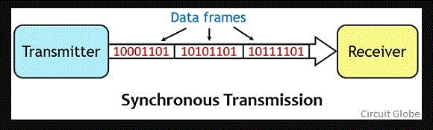
Definition of Synchronous Transmission
Here the name itself is indicating that synchronous transmission needs synchronization between transmitter and receiver in order to allow communication between the two. Basically, despite having internal clock pulses, the transmitter and receiver share a common clock pulse so as to have synchronization in communication. This means data will be transmitted between the transmitter and receiver only after a constant time interval.
The figure below represents the synchronous transmission between the sender and receiver:
It allows the transmission of data in the form of frames or blocks. Thus, a huge data amount can be transmitted between transmitter and receiver once the clock pulse is sent. This time interval is decided by the frequency of the external clock pulse. So basically in synchronous transmission, the clock pulse decides when to transmit the data and for this, both transmitter and receiver must be ready to have communication.

Slide 21
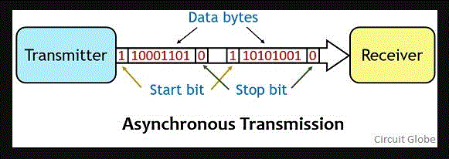
Definition of Asynchronous Transmission
Asynchronous transmission is a type of serial transmission that follows a non-synchronized form of communication. Thus start and stop bits are required in order to intimate the receiver about the beginning and end of the data stream.
The figure below shows the asynchronous transmission technique:

Slide 22
Here the data is transferred from an end to another in the form of bytes or characters. Thus when the transmitter wants to send data then it has to notify the receiver that it is going to send the data bits. So for this reason before sending the actual data the transmitter sends a start bit that notifies the receiver about the transmission.
And after sending the data byte, the transmitter sends stop bit that shows the completion of the data. The transmitter and receiver in the asynchronous transmission system have their internal clock for operation. But do not operate on a common clock pulse.
Thereby leading to unawareness about the proper transmission. Therefore, due to this reason start and stop bits are utilized in the asynchronous communication system. However, the presence of start and stop bit reduces the data transmission rate in the case of asynchronous transmission.

Slide 23
Key Differences Between Synchronous and Asynchronous Transmission
The synchronous transmission allows the transmission of data in frame or block formats. Whereas, in asynchronous transmission, a byte or character is transmitted at a time.
Due to the transmission of data in the form of frames the rate of data transmission is quite fast in synchronous transmission. While in asynchronous transmission the rate of data transmission is comparatively slow.
Synchronous communication needs synchronization between sender and receiver thus the two shares a common clock pulse. On the contrary, Asynchronous communication does not permit synchronized communication and thus the sender and receiver have their own internal clock.
Due to the existence of clock pulse, data in the form of frames can be continuously transmitted between sender and receiver. While the absence of a common clock pulse causes the existence of gaps between data bits.

Slide 24
The synchronous transmission does not require start and stop bits. As against in order to have asynchronous transmission between sender and receiver, start and stop bits are necessarily needed before and after the message signal bits.
The time interval of transmission remains constant between the data to be transmitted. However, in the case of asynchronous transmission variable time intervals between the data bits exist.
A system supporting synchronous transmission is comparatively complex than asynchronous transmission system.
Due to synchronized communication, the synchronous transmission is more efficient compared to asynchronous transmission.
The complexing of the system in synchronous transmission increases the cost of the system. Thus synchronous transmission is more expensive than asynchronous transmission.

Slide 25
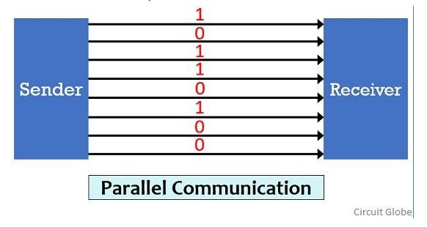
Definition of Parallel Communication
In parallel communication the various data bits are simultaneously transmitted using multiple communication links between sender and receiver. Here, despite using a single channel between sender and receiver, various links are used and each bit of data is transmitted separately over all the communication link.
The figure below shows the transmission of 8 byte data using parallel communication technique:

Slide 26
Here, as we can see that for the transmission of 8-bit of data, 8 separate communication links are utilized.
And so rather following a sequential data transmission, simultaneous transmission of data is allowed. This leads to a faster communication between the sender and receiver.
But for connecting multiple lines between sender and receiver multiple connecting unit are to be present between a pair of sender and receiver.
And this is the reason why parallel communication is not suitable for long distance transmission, because connecting multiple lines to large distances is very difficult and expensive.

Slide 27
Differences Between Serial and Parallel Communication
Due to the presence of single communication link the speed of data transmission is slow. While multiple links in case of parallel communication allows data transmission at comparatively faster rate.
Whenever there exists a need for system up-gradation then upgrading a system that uses serial communication is quite an easy task as compared to upgrading a parallel communication system.
In serial communication, the all data bits are transmitted over a common channel thus proper spacing is required to be maintained in order to avoid interference. While in parallel communication, the utilization of multiple link reduces the chances of interference between the transmitted bits.
Serial communication supports higher bandwidth while parallel communication supports comparatively lower bandwidth.
Serial communication is efficient for high frequency operation. However, parallel communication shows its suitability more in case of low frequency operations.
Due to existence of single link, the problem of crosstalk is not present in serial communication. But multiple links increase the chances of crosstalk in parallel communication.
Serial communication is suitable for long distance transmission of data as against parallel communication is suitable for short distance transmission of data.

Slide 28
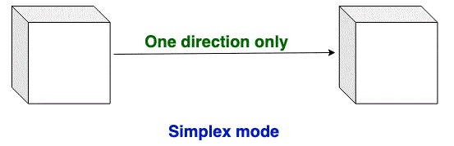
Transmission Modes in Computer Networks
There are 3 types of transmission modes which are given below: Simplex mode, Half duplex mode, and Full-duplex mode.
Simplex mode: In simplex mode, Sender can send the data but the sender can’t receive the data. It is a unidirectional communication.
Half-duplex mode: In half-duplex mode, Sender can send the data and also can receive the data one at a time. It is two-way directional communication but one at a time.
Full duplex mode: In full-duplex mode, Sender can send the data and also can receive the data simultaneously. It is two-way directional communication simultaneously.

Slide 29
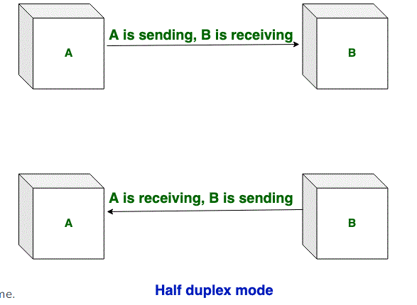
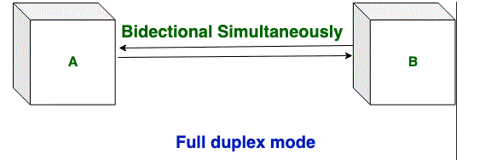

Slide 30
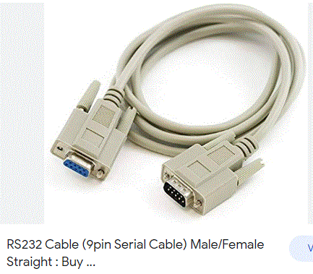
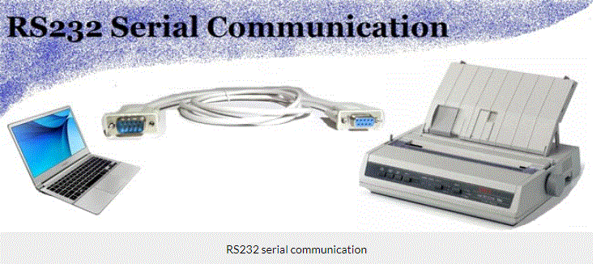
RS 232 cable

Slide 31
Features and application of RS 232 cable
RS232 cables support a typical transmission speed of 9600 bps at 15 m. They provide asynchronous communication capabilities with hardware flow control, software flow control, and parity checking. Most gears, instruments with digital control interfaces, and communication devices have an RS232 interface.
The application may determine the cable's dimensional and electrical specifications, as well as its end connectors and approvals and certifications.
Suppliers offer serial cables for audio / video (A/V), automotive, imaging, medical, radio frequency (RF), and telecommunications applications.
There are also cables for personal computers (PCs), local area network (LAN) and Ethernet applications, and industrial control and instrumentation systems.

Slide 32
Features & Benefits
Best-in-Class Shield Technology: Patented Beldfoil shield technology offers 100% coverage, preventing outside noise from affecting the signal
Multiple Temperature Options: Range of jacket material options suited for different temperature ratings and budget requirements
Longer Transmission Distances: Lower capacitance allows signal transmission over extended distances
Simplified Installation: Cables use finely stranded conductors for increased flexibility
Easy to Spec & Design: Offered in a range of gauge sizes, shielding options, conductor types and pair counts

Slide 33
What is RS232?
RS232C “Recommended Standard 232C” is the recent version of Standard 25 pin whereas, RS232D which is of 22 pins. In new PC’s male D-type which is of 9 pins.
RS232 is a standard protocol used for serial communication, it is used for connecting computer and its peripheral devices to allow serial data exchange between them. As it obtains the voltage for the path used for the data exchange between the devices. It is used in serial communication up to 50 feet with the rate of 1.492kbps. As EIA defines, the RS232 is used for connecting Data Transmission Equipment (DTE) and Data Communication Equipment (DCE).
Universal Asynchronous Data Receiver &Transmitter (UART) used in connection with RS232 for transferring data between printer and computer. The microcontrollers are not able to handle such kind of voltage levels, connectors are connected between RS232 signals. These connectors are known as the DB-9 Connector as a serial port and they are of two type’s Male connector (DTE) & Female connector (DCE).

Slide 34
IEEE 1284
is a standard that defines bi-directional parallel communications between computers and other devices. The IEEE 1284 standard allows for faster throughput and bidirectional data flow with a theoretical maximum throughput of 4 megabytes per second; actual throughput is around 2 megabytes/second depending on hardware.
In the printer venue, this allows for faster printing and back-channel status and management. Since the new standard allowed the peripheral to send large amounts of data back to the host, devices that had previously used SCSI interfaces could be produced at a much lower cost. This included scanners, tape drives, hard disks, computer networks connected directly via parallel interface, network adapters and other devices. No longer was the consumer required to purchase an expensive SCSI card—they could simply use their built-in parallel interface.

